Slide 1
Welcome to the Wild Wild Web

Slide 2
The Dawn of the Web: From Humble Beginnings to "Googly" Eyes

Slide 3
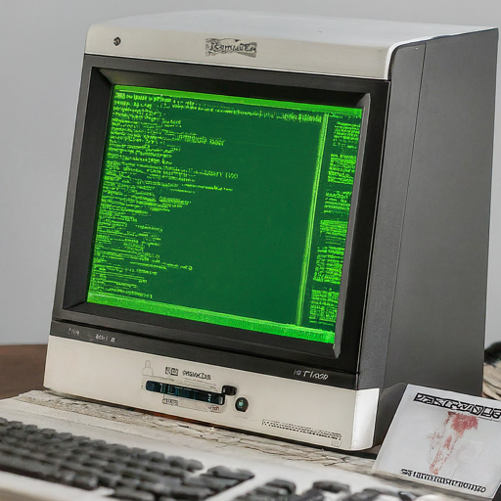
The Web's grandpappy: Tim Berners-Lee, a computer scientist at CERN, invents the World Wide Web in 1989.
Back then, websites looked like code puke – no fancy graphics, just pure text.
Imagine Tinder profiles with just a list of IP addresses...yikes!

Slide 4
Dial-Up Days: The Sound of the Internet

Slide 5
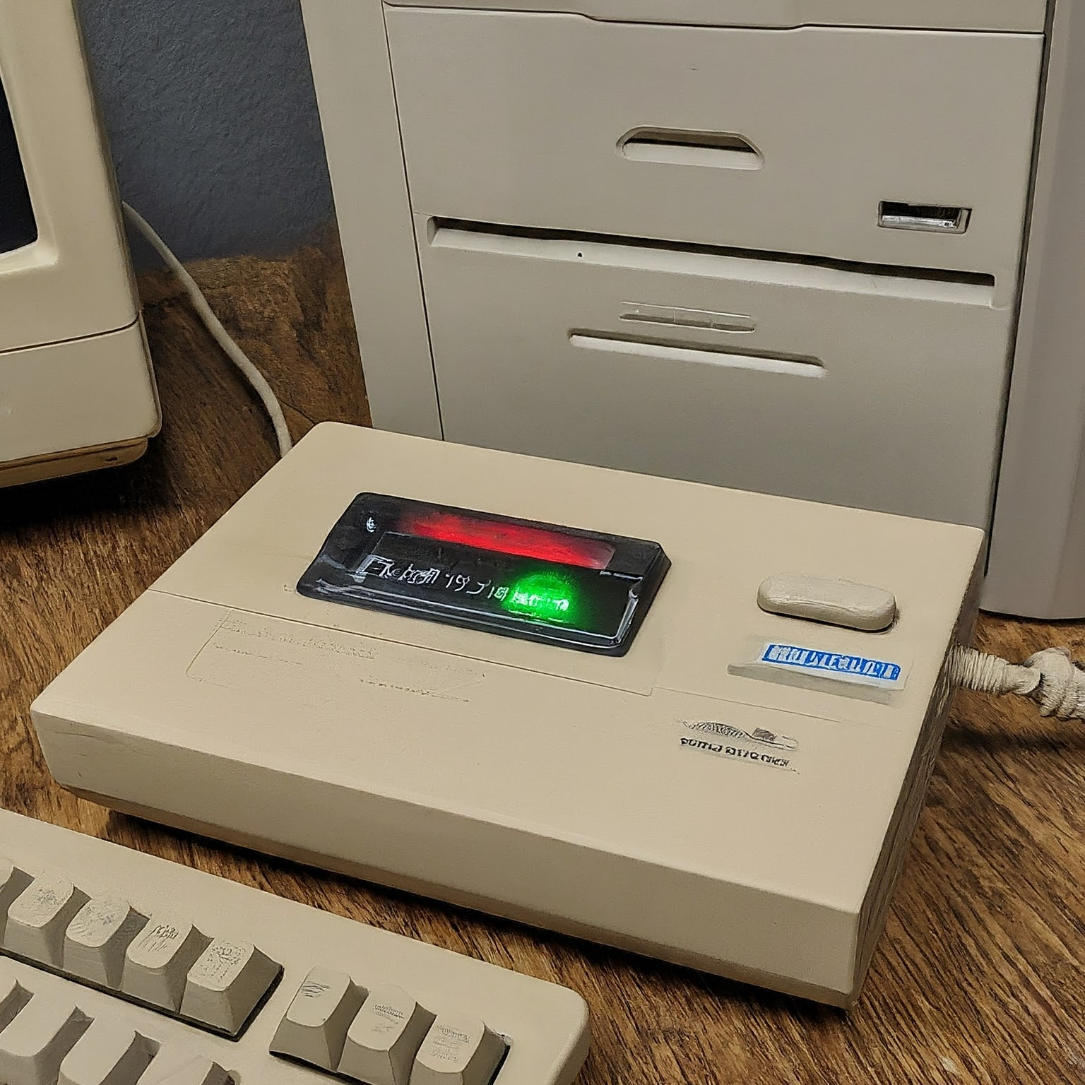
Ah, dial-up
Waiting for a webpage to load felt like an eternity, perfect for practicing your patience (or rage-quitting).

Slide 6
The Rise of the Social Web: From Myspace to Selfies

Slide 7
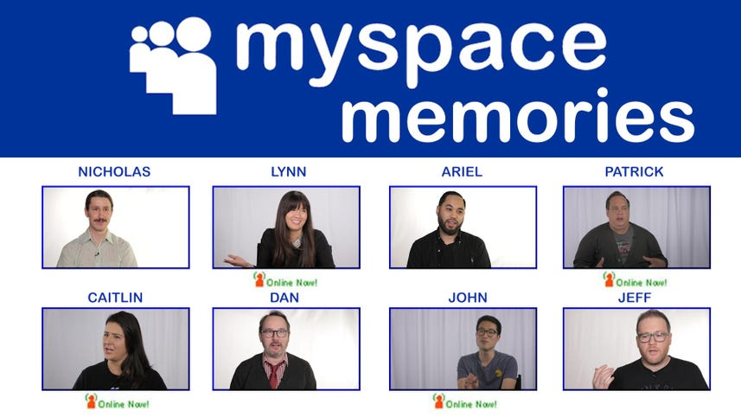
The selfie craze began – everyone became their own paparazzi, documenting their every move (and duckface) and sometimes their food.

Slide 8
The Age of the Smartphone: The Web in Your Pocket

Slide 9
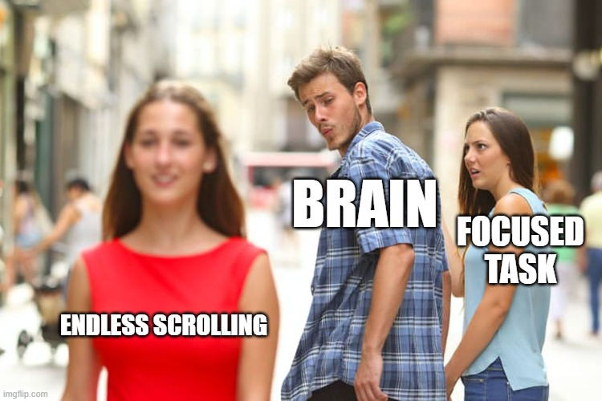
Attention spans have officially shrunk – thanks, endless scrolling!

Slide 10

Under the Hood of the Web: A Peek at the Tech Stack
Client-Server Model
HTTP Protocol
HTML, CSS, and JavaScript

Slide 11

The Web Evolves: Web 1.0, 2.0, and Beyond
Web 1.0 (1990s): The read-only web – static websites with limited user interaction.
Web 2.0 (2000s): The rise of social media and user-generated content. Think blogs, wikis, and social networking sites.
Web 3.0 (Present and Future): The semantic web – a focus on machine-readable data and artificial intelligence.

Slide 12

The Future of the Web: What's Next?
Emerging Technologies
Focus on Security and Privacy

Slide 13

The Paleontologist and web developer
A paleontologist and a web developer are at a bar. The paleontologist says, "You know, my job is pretty tough. It takes years to dig up fossils and piece together the history of life on Earth." The web developer replies, "Yeah, but at least you don't have to deal with browser compatibility issues across different versions of Internet Explorer!"

